Slide 1


Experiential Engineering Education (ExEEd) - prototype and design building
FOOD ANALYSIS USING IMAGE PROCESSING

Slide 2
Name of the student | Vaishnavi Velumula
Roll no. | 21951A66F8
Branch | CSE(AI&ML)
Email ID | 21951A66F8@iare.ac.in
Mobile Number | 7013462242
Name of the studdent | Smrithi Yennum
Roll no | 21951A66F0
branch | CSE(AI&ML)
Email ID | 21951A66F0@iare.ac.in
Mobile number | 7569048363

Slide 3
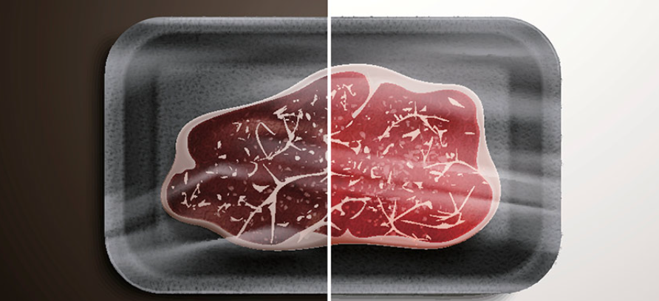
Title of Proposed Idea / Innovation
FOOD ANALYSIS USING IMAGE PROCESSING

Slide 4
Problem Definition
Developing a dietary assessment system that records daily food intake through the use of food images taken at a meal. The food images are then analyzed to extract the nutrient content in the food. Building a more transparent and secure global food system using image recognition and machine learning is ImpactVision’s answer to food waste and fraud.

Slide 5
Briefly explain newness / uniqueness of the innovation
Innovation combines two important factors diet and health. Dietary assessment, the process of determining what someone eats during the course of a day, is essential for understanding the link between diet and health.
The uniqueness of the innovation is that it not only tells if the food is good or not, but it also gives the information about the nutrition present in the food.
It will be a handy app for all the people who are very conscious about their health.

Slide 6
Concept & Objective
There are three main components of our food segmentation and identification approach: image segmentation, feature extraction and classification, and segmentation refinement. Traditional segmentation methods usually require user-specified input parameters which can result in under-segmentation or over-segmentation. To obtain a stable segmentation, we propose to combine image segmentation and classification using a segmentation refinement step in which the classification feedback can be used to refine image segmentation until maximal classification confidence has been achieved.

Slide 7
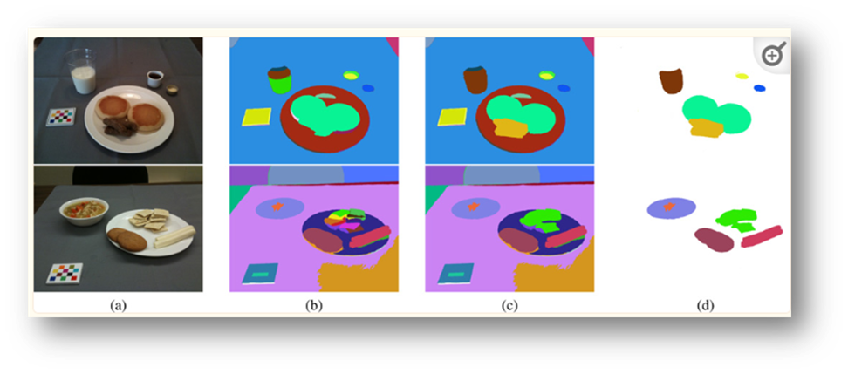

Slide 8
Specify the potential areas of application in industry / market in brief
Building a more transparent and secure global food system using image recognition and machine learning is ImpactVision’s answer to food waste and fraud.
The special software in it provides the details of the nutrition present in the food. It also gives the information about the freshness of the food.
It helps people in maintaining a proper diet and have a good health.

Slide 9
Briefly provide the market potential of Idea / Innovation
The market potential for the Food Analysis By Image Processing system is substantial, as it is developed by a special software, combined with digital imagining and a chemical technique which uses a picture to detect the food's nutritional content, freshness and moisture.
The app/system provides the beneficial information for the people regarding the most essential thing – FOOD. It will be a very easy and helpful app for all the people.
It includes many features as discussed above. Hence, people would also like to use this app as it helps them in maintaining good health.

Slide 10
Thank you

